Slide 1
Emotion Recognition Solution
Sergey Tarasenko, PhD

Slide 2
Table of Content
Task Definition
Data Overview (EDA)
Model Development
Solution Recommendations

Slide 3
Task Definition

Slide 4
Why Emotion Recognition is important?
Human emotions play important role in human social life. Therefore, human emotion recognition is becoming increasingly vital in various industries as it:
enhances customer interactions
provide deep insight into current state of mind of a person
improves employee engagement
drives better decision-making.
By understanding emotional cues:
businesses can tailor their services to meet client needs more effectively
fostering loyalty
increase client satisfaction
In the workplace, recognizing employee emotions can lead to a more supportive environment, promoting well-being and productivity.
Therefore, recognizing human emotions is a fundamental task to be solves. Since emotion are everywhere in our life, such a solution should be of high demand.

Slide 5


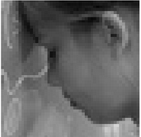
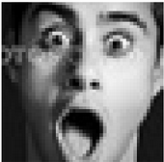
Task Definition
We are given a dataset of grayscale images, which contain human faces with 4 types of emotion expressions:
Happy
Neural
Sad
Surprise
Our task includes 3 key points:
Develop a robust solution for Emotion recognition
Explain system deployment and limitations
Explain business value
Happy
Neutral
Sad
Surprise

Slide 6
Data Overview (EDA)

Slide 7
Data overview (EDA)
Provided images is already splitted into train, validation and test datasets. Each dataset constrain 4 classes, i.e., happy, neural, sad, surprise.
Key finding about the datasets:
Images in all three datasets contain faces of people of various genders (men, women), ages (child, teenager, adult), ethnicity
Pictures of faces are taken from different distance, from different angles, against various backgrounds, face can appear in different location of an image
Some images contain noise in a form of irrelevant text
Some people wear glasses (both sunglasses and optical devices) with both transparent and completely opaque lens

Slide 8
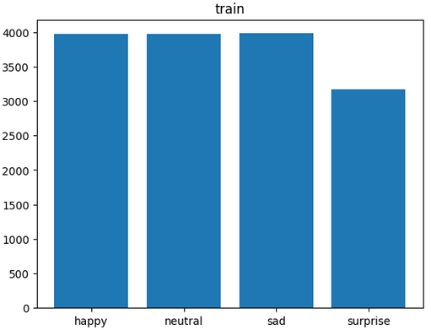
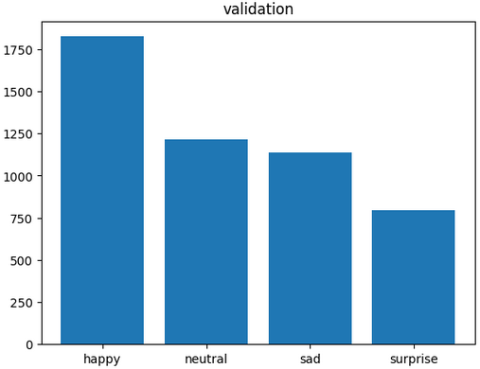
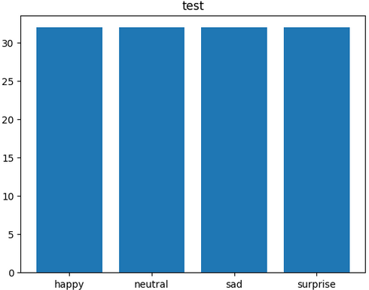
Data overview (EDA)
Key finding about the datasets:
Training dataset contains 15109 images
Validation dataset contains 4977 images
Test dataset contains 128 images
Images are distributed across classes for each data set as follows:
We can infer that in the case of:
Train dataset: surprise class contains about 21% sample less than other 3 classes
Test dataset : all four classes contain the same number of samples (32)
Validation dataset has highly unbalanced distribution of images across classes

Slide 9
Model Development

Slide 10
Model Development
Model Type
Given the observations from EDA, we decided to stick to Convolutional Neural Networks as they are contain filters to account for spatial dependencies, shift-invariant recognition and trainable parameters’ sharing.
Quality Metrics
Emotion recognition is a classification task. Therefore we have selected the following metrics:
training , validation accuracy to trace model training
Test accuracy to access model using test dataset
Recall, precision and f1-sore for each class as well as their weighted average, to assess how well network is recognising classes
Confusion matrix to visualize distribution of classified samples across classes. This also help to see the errors in form of False Positive and False Negative.

Slide 11
Model Development
Techniques to find a good model
Check RGB vs. GrayScale input: RGB input models show higher performance
Under/Over sample Training Dataset: Oversampling training dataset has a positive effect
Vary batch size: model trained using batch size of 32 has the best performance
Vary kernel size: model trained using kernel size 2x2 has the better performance when using kernel size 3x3
Add regularization to eliminate overfitting: did not work in a good way, model performance dropped
Data augmentation: did not provide any performance improvement
Use different CNN models of different depth
Build CNN by increasing or decreasing number of filters in each following layer: increasing number of filters had obvious positive effect
Apply transfer learning using partial training (only classifier) or complete re-training: complete retraining has improvement effect for VGG16 model, but not for other models
Appy skip connections: resulted in essential improvement
Early stopping
Learning rate decay

Slide 12
Model Development
Framework to manage experiments
Having various dimensions which influence model performance, requires effective mechanism of running multiple experiments and tracking and saving results.
For this purpose a unified frame to run experiments has been created.
Key features of the unified framework:
Functions to compute predictions, confusion matrices and classification report
Functions to save:
best models,
training and validation learning curves ,
confusion matrices
classification reports
Model configs
Unified config format for models
Collect results for all models in one dataframe

Slide 13
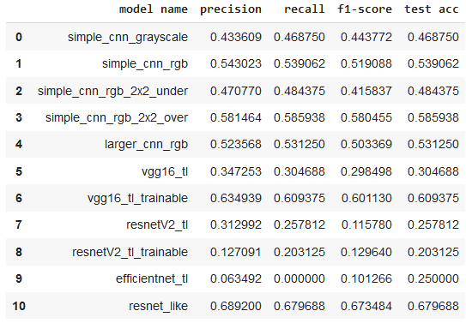
Model Development
Metrics for Selected Models:
Simple CNN Grayscale
Simple CNN RGB
Simple CNN RGB kernel 2x2 trained on undersampled data
Simple CNN RGB kernel 2x2 trained on oversampled data
Larger CNN RGB
VGG16 Transfer Learning non-trainable
VGG16 Transfer Learning trainable
ResNetV2 Transfer Learning non-trainable
ResNetV2 Transfer Learning trainable
Efficient Net Transfer Learning non-trainable
ResNet-like network
Precision, Recall and F1-score are weighted averages across four classes

Slide 14
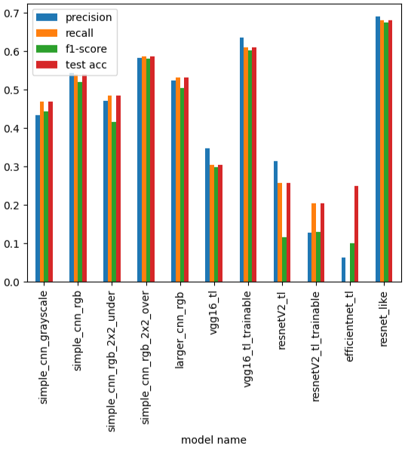
Model Development
Comparison of Selected Models:
Simple CNN Grayscale
Simple CNN RGB
Simple CNN RGB kernel 2x2 trained on undersampled data
Simple CNN RGB kernel 2x2 trained on oversampled data
Larger CNN RGB
VGG16 Transfer Learning non-trainable
VGG16 Transfer Learning trainable
ResNetV2 Transfer Learning non-trainable
ResNetV2 Transfer Learning trainable
Efficient Net Transfer Learning non-trainable
ResNet-like network
Precision, Recall and F1-score are weighted averages across four classes

Slide 15
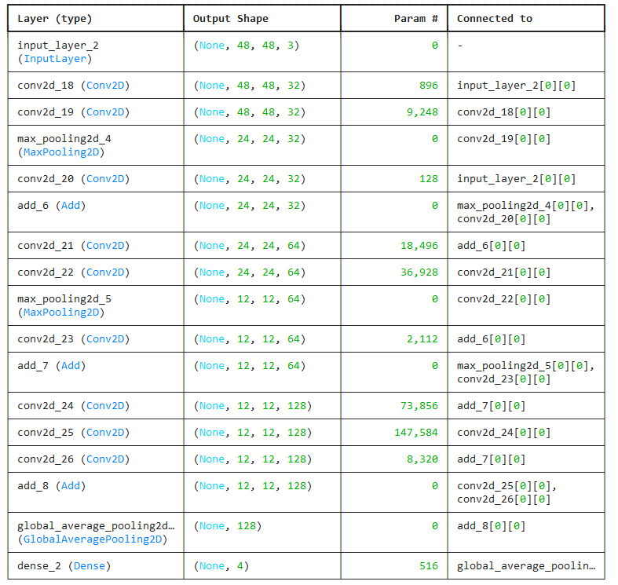
Model Development: Best Model Architecture
Input
2D Conv, 32, ReLU
2D Conv, 32, ReLU
MaxPooling
+
2D Conv, 1
2D Conv, 64, ReLU
2D Conv, 64, ReLU
2D MaxPooling, 64
+
2D Conv, 1
2D Conv, 128, ReLU
2D Conv, 128, ReLU
+
2D Conv, 1
Global Average 2D
Dense, 4, SoftMax
Output

Slide 16
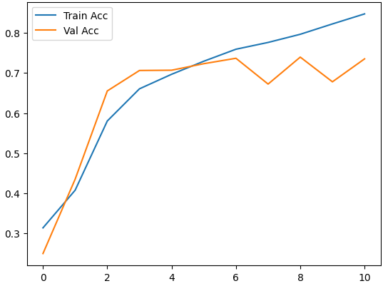

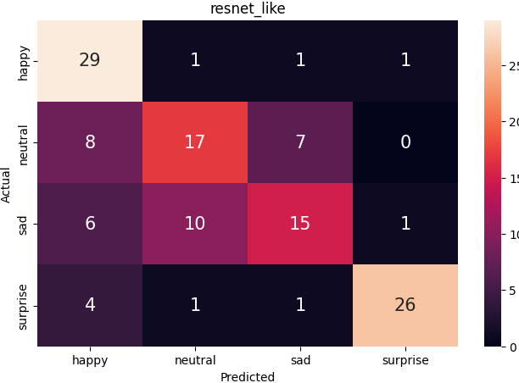
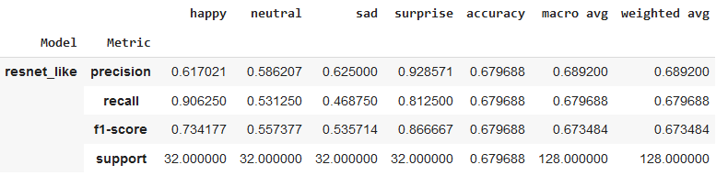
Model Development: Best Model Metrics
Best Model
The best model, which was possible to find is ResNet-like model trained on RGB images.
Model size is 298,084 params, which can be consider small model. Size of the mode is only 1.14 Mb.
Train Acc 0.796
Val Acc 0.739
Test Acc 0.679
Recall
Precision

Slide 17
Model Development: Further Improvement
Way to improve model
Collect more data
Do in-depth analysis of image distribution across classes and create new dataset
Use advanced augmentation techniques like AugMix
Use more complex CNN architectures like Vision Transformers
Use Transfer Learning from CNN trained on Emotion datasets
Run more experiments with higher granularity for hyper parameters

Slide 18
Solution Recommendations

Slide 19
Solution Recommendations: ROI
The final goal of deploying Emotion recognition model is to develop successful application and gain profit.
From financial point of view this can be measured by Return on Investment (ROI) index. This index shows the ratio of net profit (Revenue - Cost) to the cost:
Ideally, we would like to maximize the ROI, which can be done by minimizing Cost and maximizing Revenue. Here the consider way for cost reduction.
Revenue - Cost
ROI =
Cost

Slide 20
Solution Recommendations: Cost Optimization
Cost can be segregated into 2 big groups:
Costs associated with Deep Learning model (Cost_DL)
Other sources of expenses (Cost_other)
Cost = Cost_DL + Cost_other
Here we concentrate only Cost_DL.
Non-exhaustive list of sources of expense are as follows:
Model development cost: how much is cost to train a good model, including data collection and model development
Model deployment / exploitation:
Real-time prediction vs. on-demand (batch) prediction
Is GPU is necessary for inference
Response latency
Deploy on-premise vs. deploy in a cloud
Scalability

Slide 21
Solution Recommendations: Deployment/Exploitation
Real-time vs. on-demand prediction: for real time prediction we need to keep end-point and pay all the time while end-point is alive. For on-demand, only pay for time to run predictions
Is GPU is necessary for inference: if model is small then we can run model without GPU on a computer with low specs. If model is big , we need to use GPU to deliver inference in reasonable time.
Response latency: if max latency is defined in Service Level Agreement (SLA), when it is necessary to meet this requirement. If model inference time does not make it possible, then we should either consider smaller model or use GPU-enabled resources to speed-up model inference.
Deploy on-premise vs. deploy in a cloud: when deploying on premise, we have to consider Capital Expenses (CAPEX)[hardware, networking] + Operational Expenses (OPEX)[electricity and water bills, etc.]. In the case of cloud we only pay for used time, without owing hardware and networking infa. Thus, we only face OPEX.
Scalability: size of the model is determines size of Docker container and thus max number of container running together given the limited cluster resources

Slide 22
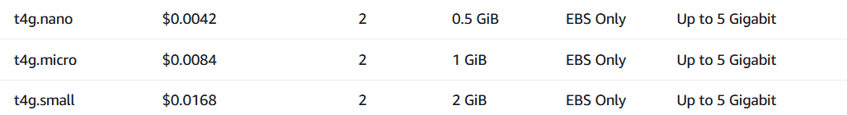
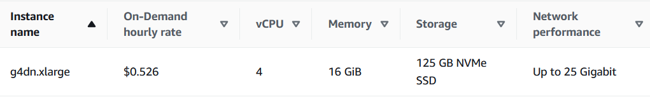
Solution Recommendations: Prices for GPU vs. Non-GPU processing
To illustrate difference cost of GPU vs. Non-GPU resource, we will use example from AWS cloud. Below, there is a cost per hour of different instances:
Non-GPU
GPU
T4 GPU
V100 GPU

